Slide 1
Role of early increased measures of inflammation and their associations with cognition and brain structure in aMCI
Bridget Balkaran
BIOS 6623 Project 4 Interim Presentation

Slide 2
Research Questions and Variables
Aim 1a: Higher baseline cytokine and chemokine levels in circulating plasma will predict
declines in memory consolidation (CVLT) and
declines in AD-signature cortical thickness
Aim 1b: Greater increases in cytokines and chemokines will be associated with
greater declines in episodic memory
and cortical thickness
Explanatory Variables
Novelty peripheral inflammatory markers
MCP-1
Eotaxin-1
Established peripheral inflamatory markers
IL-6
TNF-α
Markers of AD Pathology
β-2 Microgobulin (β2MG)
ACT
Control Variables
Age
Sex
Outcome Measures
∆ CVLT
∆Mean Cortical Thickness of AD signatures (MCT)
Potential cofounders
APOE Genotype?
BMI?
Comorbidities?
Need to evaluate if there are associated with PEVs and Outcomes and if they are correlated with the PEVs and Outcomes
If Yes -> may want to adjust for these in the model
Need to be careful because proposed sample size is small -> Will determine power for these models and see if we have enough power to detect small correlations

Slide 3
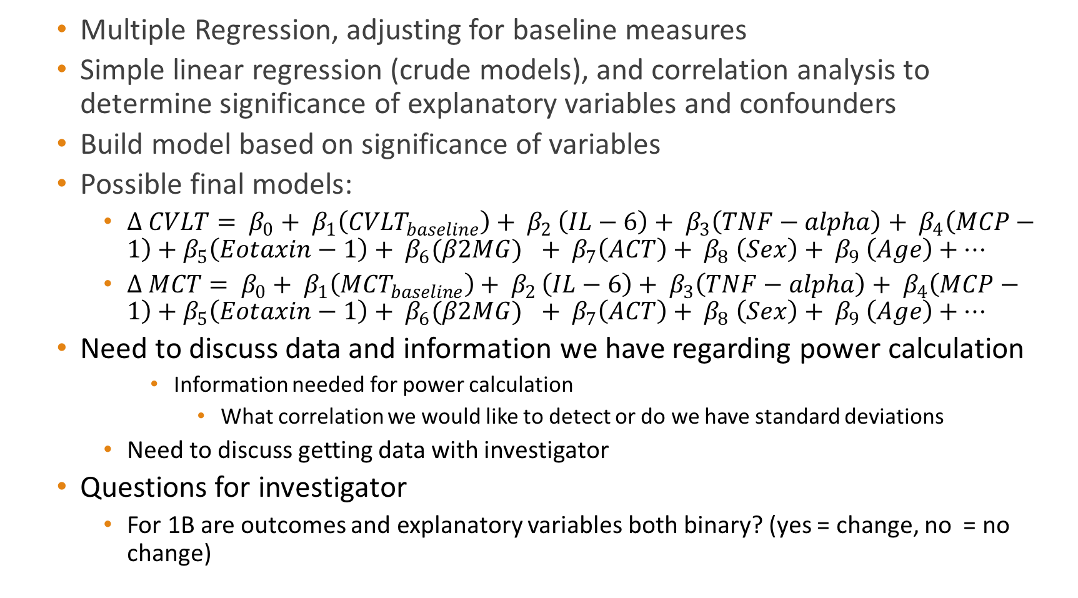
Analysis Plan and Power Calculation
Multiple Regression, adjusting for baseline measures
Simple linear regression (crude models), and correlation analysis to determine significance of explanatory variables and confounders
Build model based on significance of variables
Possible final models:
$∆ CVLT= β_{0}+ β_{1}\left({CVLT}_{baseline}\right)+ β_{2 }\left(IL−6\right)+ β_{3}\left(TNF−alpha\right)+ β_{4}\left(MCP−1\right)+β_{5}\left(Eotaxin−1\right)+ β_{6}{(β2MG)}_{}+ β_{7}\left(ACT\right)+ β_{8} \left(Sex\right)+ β_{9 }\left(Age\right)+…$
$∆ MCT= β_{0}+ β_{1}\left({MCT}_{baseline}\right)+ β_{2 }\left(IL−6\right)+ β_{3}\left(TNF−alpha\right)+ β_{4}\left(MCP−1\right)+β_{5}\left(Eotaxin−1\right)+ β_{6}{(β2MG)}_{}+ β_{7}\left(ACT\right)+ β_{8} \left(Sex\right)+ β_{9 }\left(Age\right)+…$
Need to discuss data and information we have regarding power calculation
Information needed for power calculation
What correlation we would like to detect or do we have standard deviations
Need to discuss getting data with investigator
Questions for investigator
For 1B are outcomes and explanatory variables both binary? (yes = change, no = no change)

